Slide 1
VK DESKTOP MUSIC PLAYER
Andrianov Andrei
Markowitsch Georg

Slide 2

Vk.com
VK (originally VKontakte) is the largest European social network based in St Petersburg. It is available in several languages, but is especially popular among Russian-speaking users. @Wikipedia
https://vk.com/dev/main

Slide 3
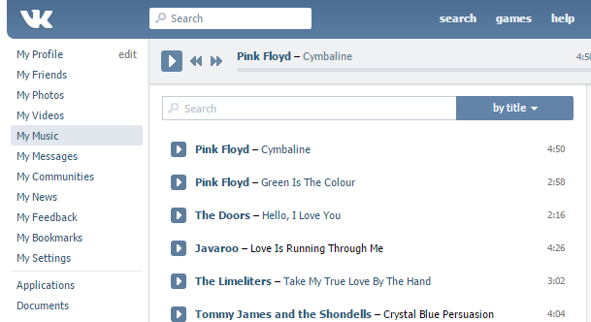

Slide 4
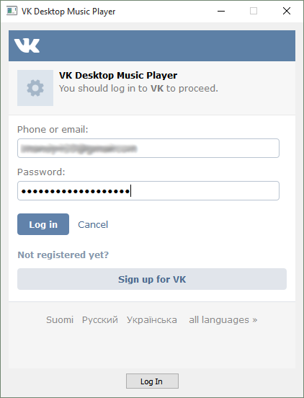

Slide 5
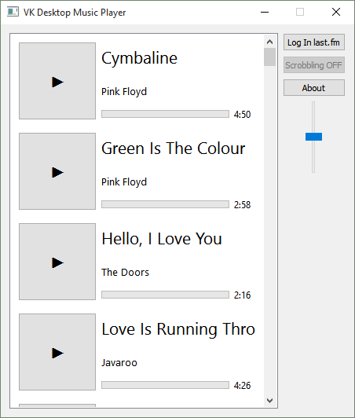

Slide 6
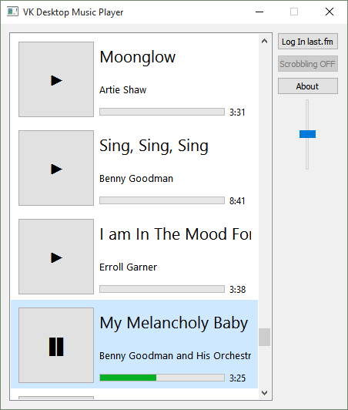

Slide 7
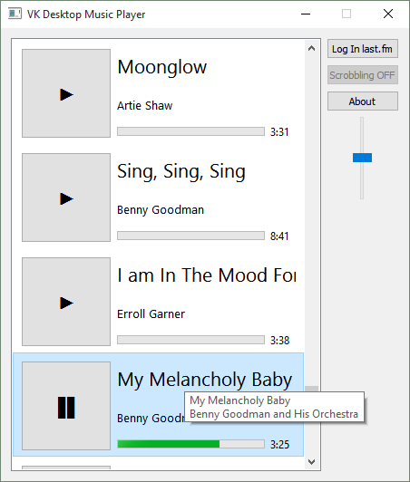

Slide 8
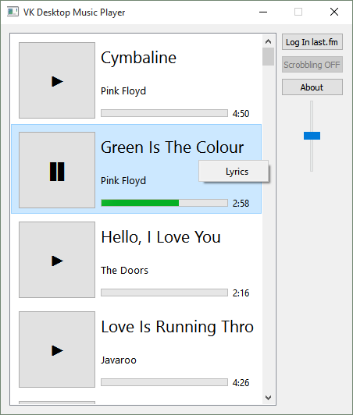

Slide 9
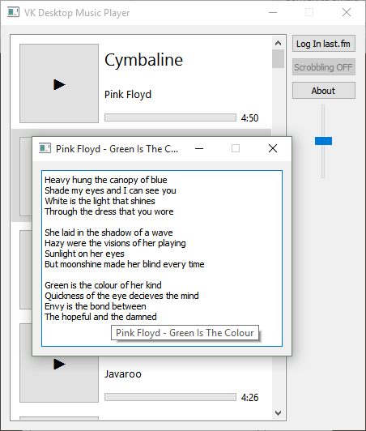

Slide 10

Last.fm
Last.fm is a music website, founded in the United Kingdom in 2002. Using a music recommender system called "Audioscrobbler", Last.fm builds a detailed profile of each user's musical taste by recording details of the tracks the user listens to, either from Internet radio stations, or the user's computer or many portable music devices. @Wikipedia
http://www.last.fm/api/intro

Slide 11
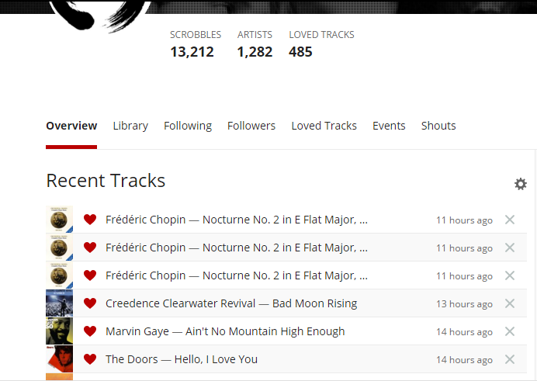

Slide 12
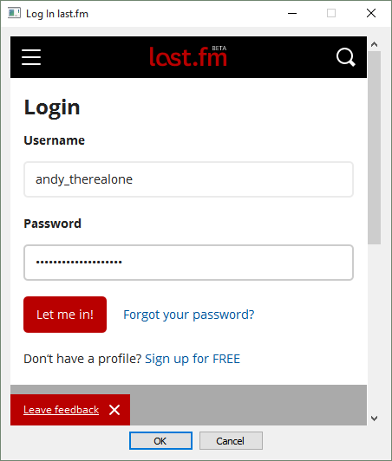

Slide 13
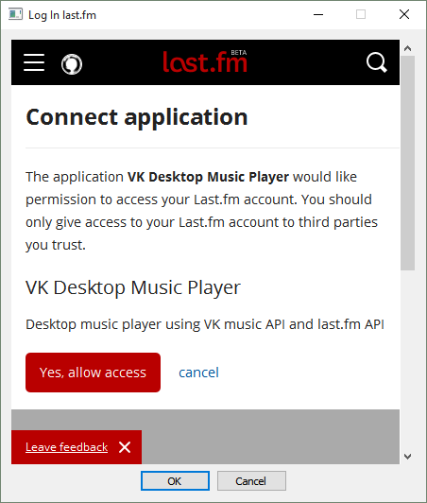

Slide 14
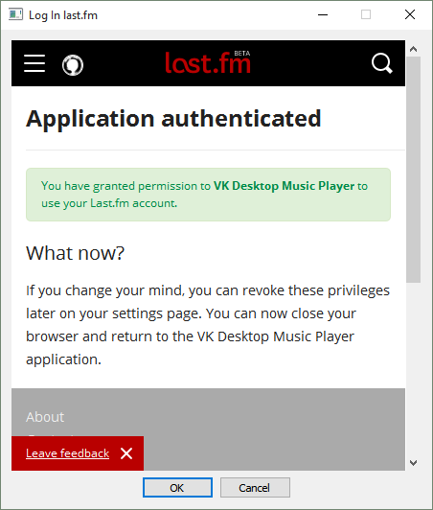

Slide 15
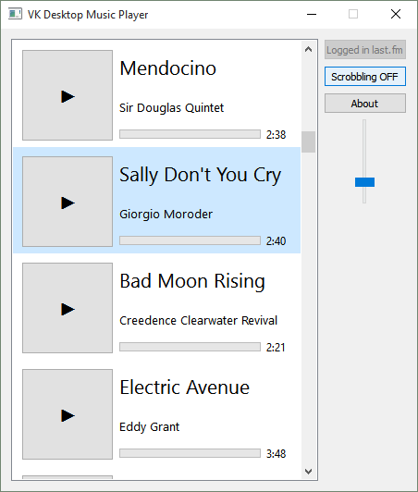

Slide 16
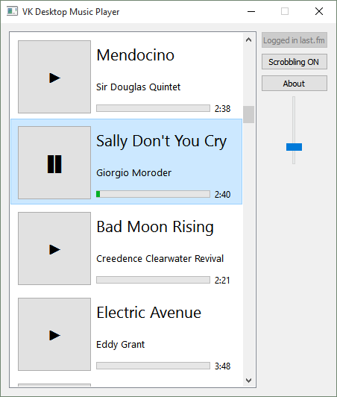

Slide 17
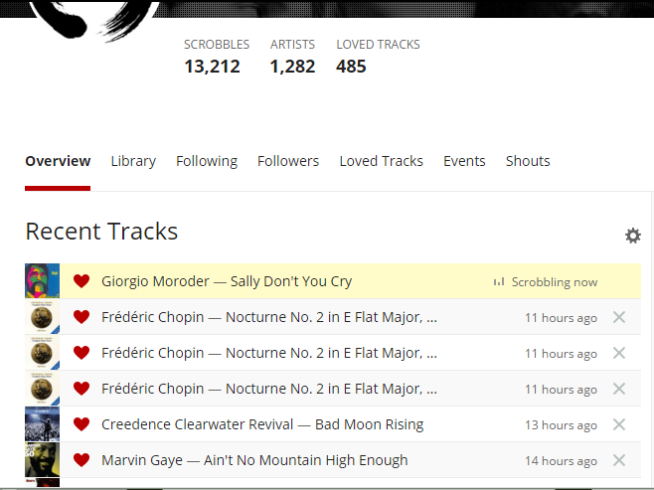

Slide 18
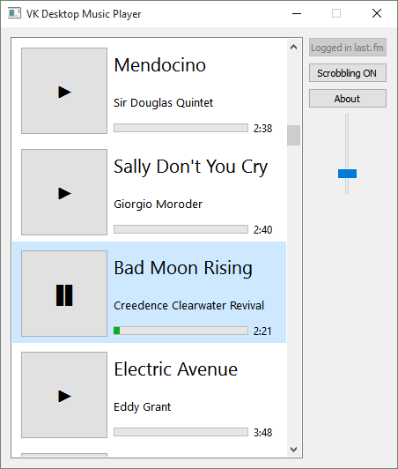

Slide 19
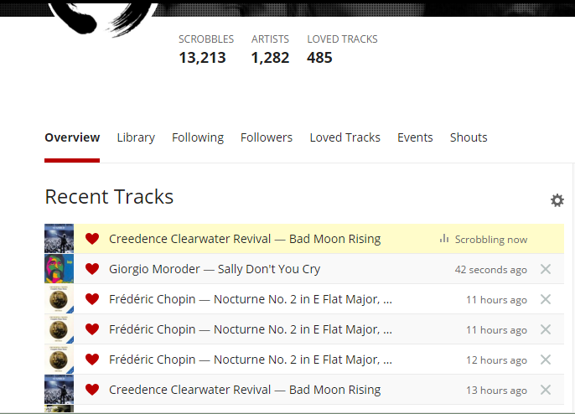

Slide 20
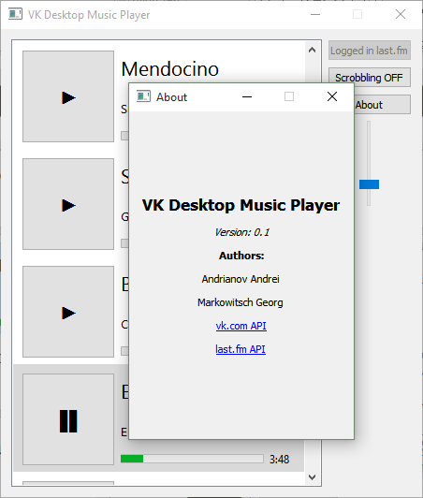

Slide 21
Some of used classes
QWidget
QMediaPlayer
QMediaPlaylist
QNetworkAccessManager
QNetworkRequest, QNetworkReply
QEventLoop
QCryptographicHash
QXmlStreamReader
QUrl, QUrlQuery
QTime, QDateTime
QMediaMetaData
QTimer
QJsonDocument
QVariantList
QVariantMap
QAction, QMenu
QByteArray
QCursor

Slide 22


Thank you for your attention

